Slide 1











Exploring Cancer Mortality in the US
Sibasish Sinha

Slide 2

Introduction

Slide 3
Background and Purpose
This project explores the causes of cancer. In the course of this project, 6 factors have been explored:
Obesity
Physical Activity
Alcohol Consumption
Smoking
Poverty
Fast Food Availability

Slide 4
Data Collection
Global Health Data Exchange (GHDx) is a new data catalog for demographic, public health and global health data. It was developed by the Institute for Health Metrics and Evaluation (IHME) at the University of Washington and it complements HealthData.gov data and hosts large health-related datasets and is geared towards providing innovators and entrepreneurs to access and utilize federal health related datasets.
Cancer mortality (number of deaths attributed to cancer per 100K people), Smoking Prevalence (number of smokers per 100 people), Alcohol Prevalence (Heavy (defined as 2 drinks per day) drinking per 100 people) data has been sourced from GHDx website (http://ghdx.healthdata.org/geography/united-states-america )
Obesity (number of people per 100 defined as Obese) and Physical Activity (number of people per 100 with any sort of physical activity) has been sourced from the IMHE website ( http://www.healthdata.org/us-health/data-download )
Poverty data came from US Government census ( https://www.census.gov/data-tools/demo/saipe/#/?map_geoSelector=aa_c&s_year=2011,2010,2009,2008,2007,2006,2005&map_yearSelector=2011 )
Fast Food data came from the USDA Economic Research Service (https://www.ers.usda.gov/amber-waves/2010/december/data-feature-compare-your-areas-food-environment-with-the-rest-of-the-country/ )

Slide 5
Data Cleansing and Challenges
Range: Data is available for different time periods, e.g. Cancer Mortality data is available from 1980-2014, while data for Smoking Prevalence is available from 1996-2002. Eventually, considering all the datasets, a common time period of 2005-2011 was settled down on
County Lookup: Datasets come with different keys, e.g. Autauga County, Autauga, Autauga County/ Alabama. All of this was standardized in MS Excel through multiple iterations of VLOOKUP and string concatenation. This also took care of county names like Adams County which can be found in multiple states
Horizontal and Vertical Data: Data was available both horizontally and vertically. All of it was to be converted into vertical data for usage in Tableau. To this effect, Python was used to append annual data vertically
Data Exclusion: Alaska and Puerto Rico have been excluded from the analysis

Slide 6
Desriptive Analysis

Slide 7
Cancer Mortality
Cancer mortality in 2011 is highest in Union County, Arkansas. Incidentally, this county has a higher than average Obesity Prevalence and higher than average Smoking population

Slide 8
Alcohol Consumption

Slide 9
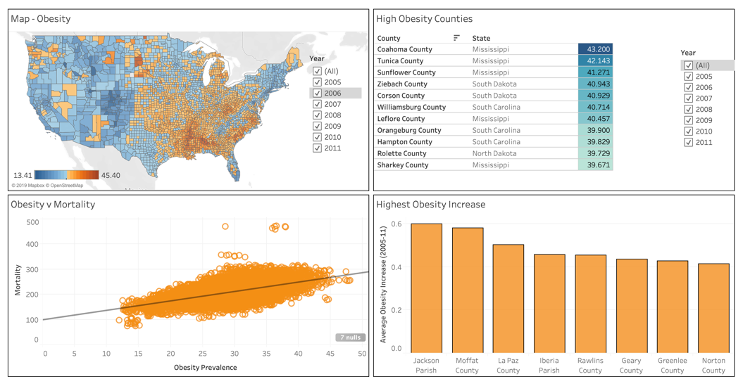
Obesity Prevalence

Slide 10
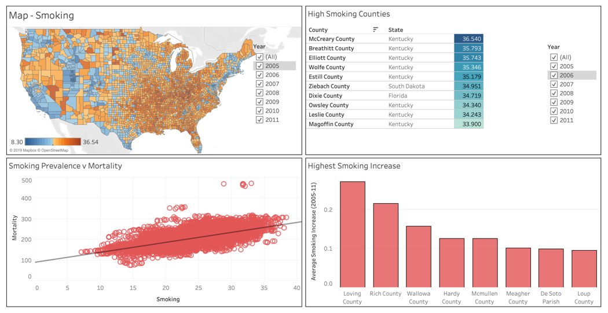
Smoking Prevalence

Slide 11
Physical Activity

Slide 12
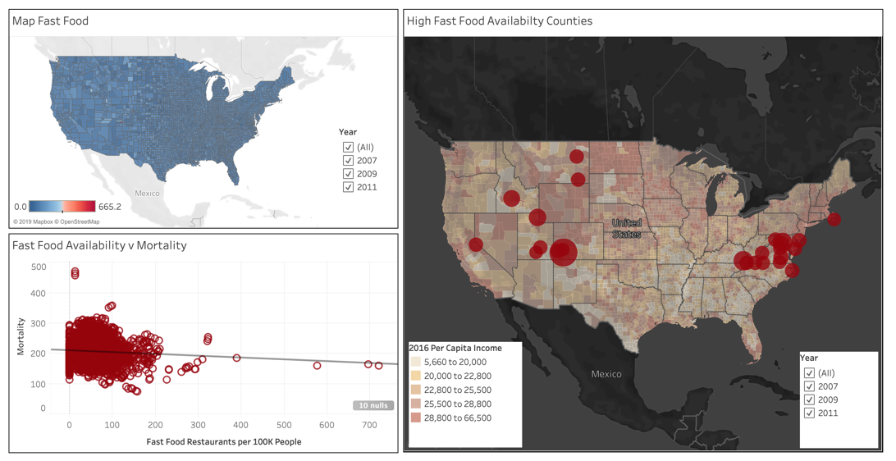
Fast Food Restaurant Availability

Slide 13
Poverty Prevalence

Slide 14
Predictive Analysis

Slide 15
How is the Mortality Data spread
The mortality values are distributed normally without outliers

Slide 16
Correlation
A correlation matrix measures the linear relationships between the variables. We can see that Mortality is positively correlated with Obesity, Smoking, Poverty, while negatively correlated with Physical Activity, Alcohol Consumption and almost not correlated with Fast Food Consumption

Slide 17
Modeling Steps
1. Reshape the data to Predictor and Target
(8466, 6) (8466, 1)
2. Splitting the dataset to Test and Train
X_train shape : (6349, 6) X_test shape : (2117, 6) y_train shape : (6349, 1) y_test shape : (2117, 1)

Slide 18
Modeling Steps (contd.)
3. Run Linear Regression and get the results
Intercept: [166.46944176] Coefficients: [[ 1.24517954, 2.85674931, 0.11152996, -1.04385952, 0.49525941, -0.7340646 ]]
4. Score the models
Mean Squared Error (MSE): 410.2218243717601
R-squared (R2 ): 0.5180600204829056
5. Score the models
Training Score: 0.5365783959194668 Testing Score: 0.5581231858941932

Slide 19
Modeling Steps (contd.)
6. The magic formula
Mortality = 166.47 + 1.25 * Obesity Prevalence + 2.86 * Smoking + 0.11 * Fast Food - 1.04 * Physical Activity + 0.50 * Poverty - 0.73 * Heavy Drinking
7. Plotting the residuals

Slide 20

Inferences
We have a high error and low co-efficient model
Model can be right 56% of the time
Or it could simply mean that the factors chosen are not capable of predicting cancer mortality
And there are 100s of cancer varieties, each with their own causes and idiosyncrasies, might be narrowing to a specific type of cancer could make these variables “predictors”

Slide 21
Notes to Self
1. Datasets are quirky and unpredictable. Data science is mostly data engineering. So, pace oneself properly
2. Data standardization is key to avoiding “data hell”. Creating clean dimension tables help
3. Treat outliers
4. More the variables, the better. More iterations, even better
5. Finally, take the model with a pinch of salt

Slide 22
Questions

Slide 23











Thank You

